Slide 1

Wellcome
To
Ethical Hacking Class
3rd Week
Day 1st

Slide 2
Network Scanning Fundamentals
Definition:
Network scanning is the process of identifying active hosts on a network, discovering open ports, and gathering information about network services and devices. It is a crucial step in network security assessment and management, as it helps identify potential vulnerabilities.
Examples:
1.Identifying Active Hosts: An IT administrator uses a network scanning tool to detect all devices connected to a corporate network. This helps ensure that no unauthorized devices are connected.
2.Discovering Open Ports: A security analyst scans a web server to find open ports, which may indicate running services that could be vulnerable to attack.
Techniques and Tools:
Techniques:
- Ping scanning
- TCP/UDP scanning
- Stealth scanning
Tools/Websites:
Nmap: A powerful open-source network scanner.
Angry IP Scanner: A fast and easy-to-use IP address and port scanner.

Slide 3

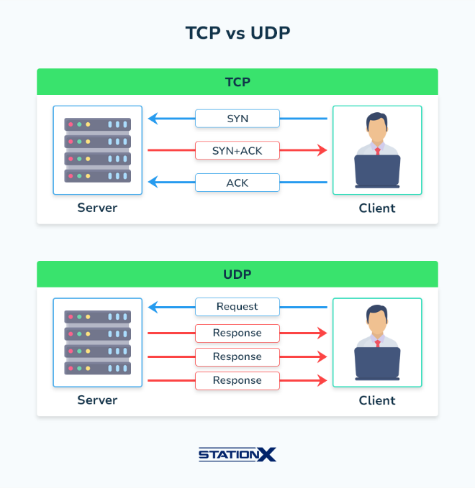
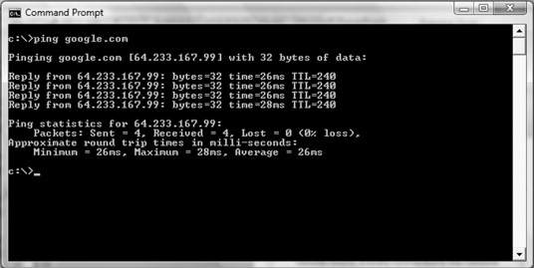

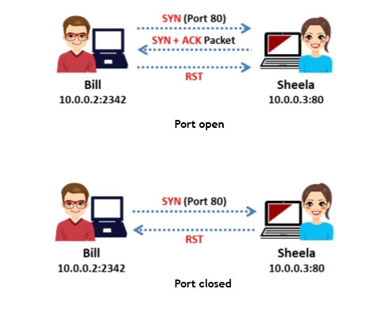
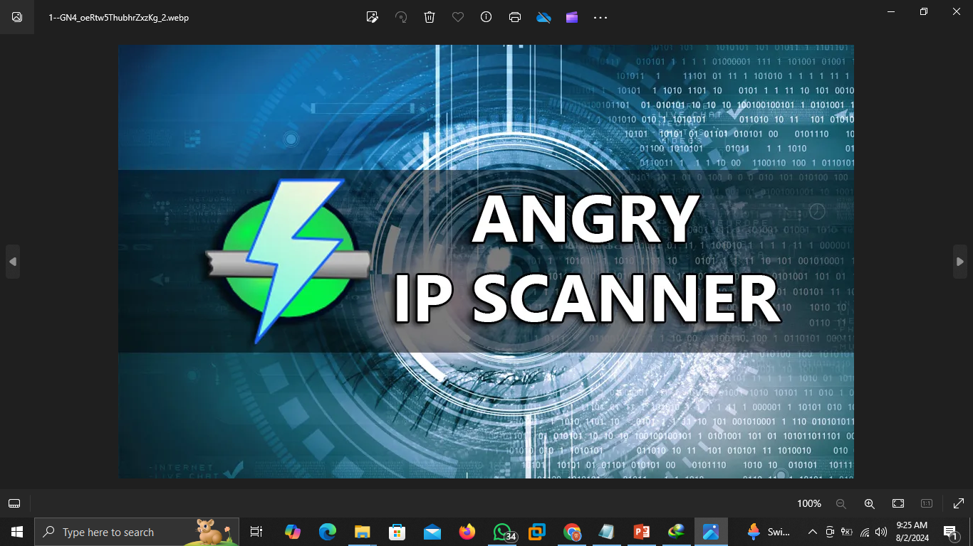
Network Scanning Fundamentals

Slide 4
Network Scanning Fundamentals
Types of Network Scans
Definition:
Network scans can be categorized based on the methods used to discover devices and services on a network. Each type of scan serves a different purpose and varies in terms of speed, stealth, and information gathered.
Examples:
1. Ping Scan: A method to quickly identify live hosts by sending ICMP echo requests.
2. SYN Scan (Stealth Scan): A half-open scan where a SYN packet is sent, and the response is analyzed to determine if a port is open.
Techniques and Tools:
Techniques:
- SYN scan
- ACK scan
- FIN scan
- Xmas scan
Tools/Websites:
Nmap: Supports various types of scans such as SYN, ACK, and FIN.
Zenmap: The graphical interface for Nmap, which helps in visualizing scan results.

Slide 5
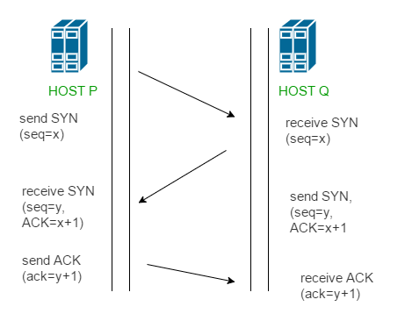
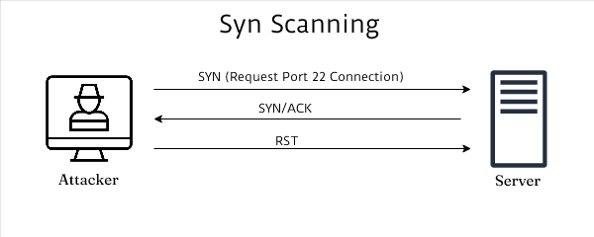
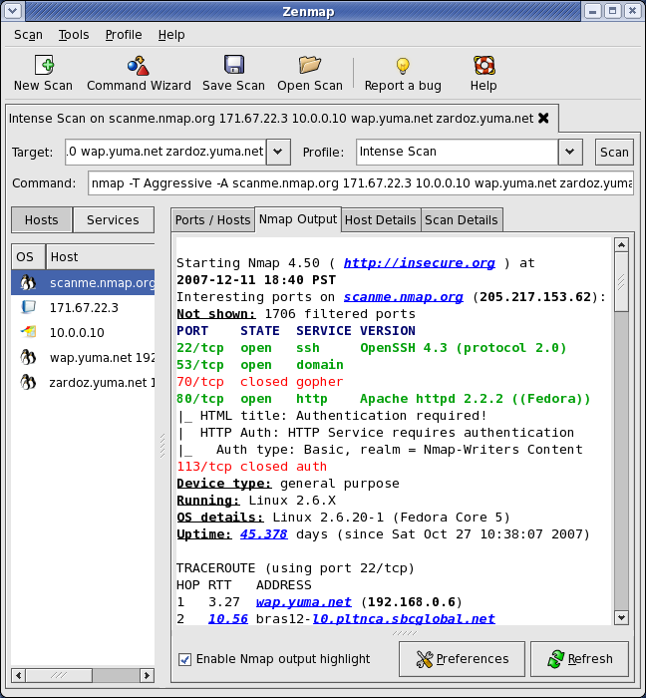
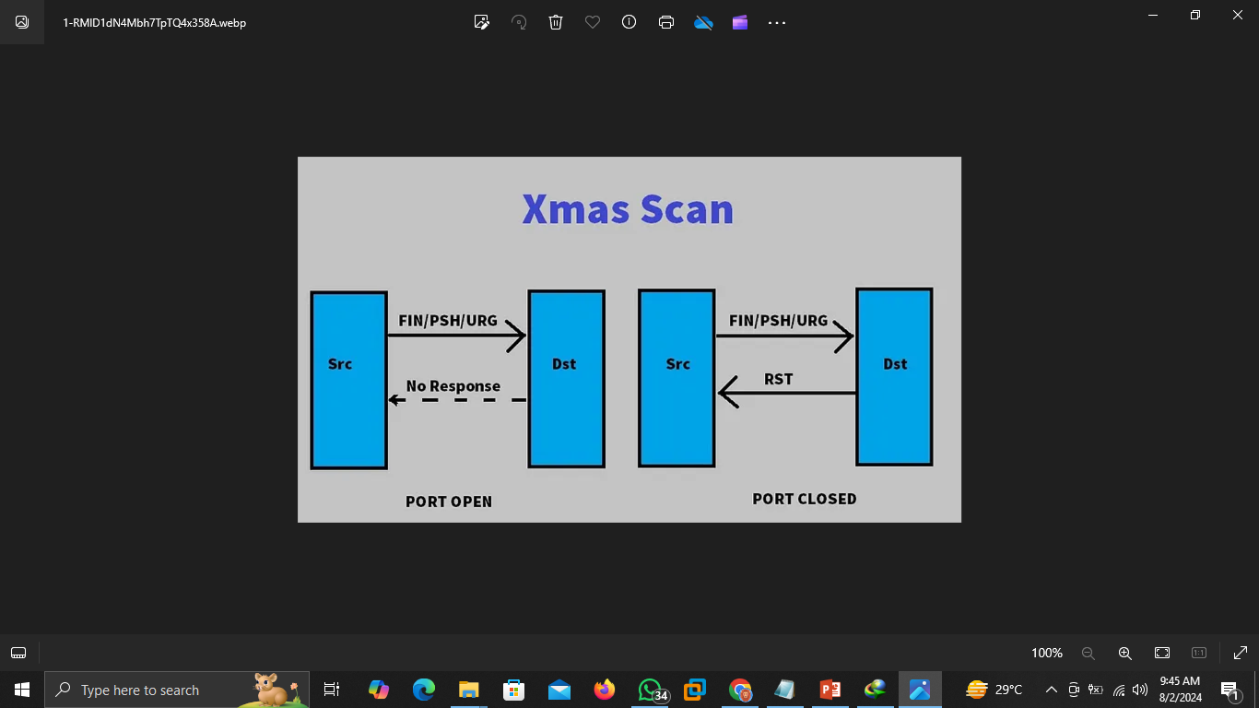
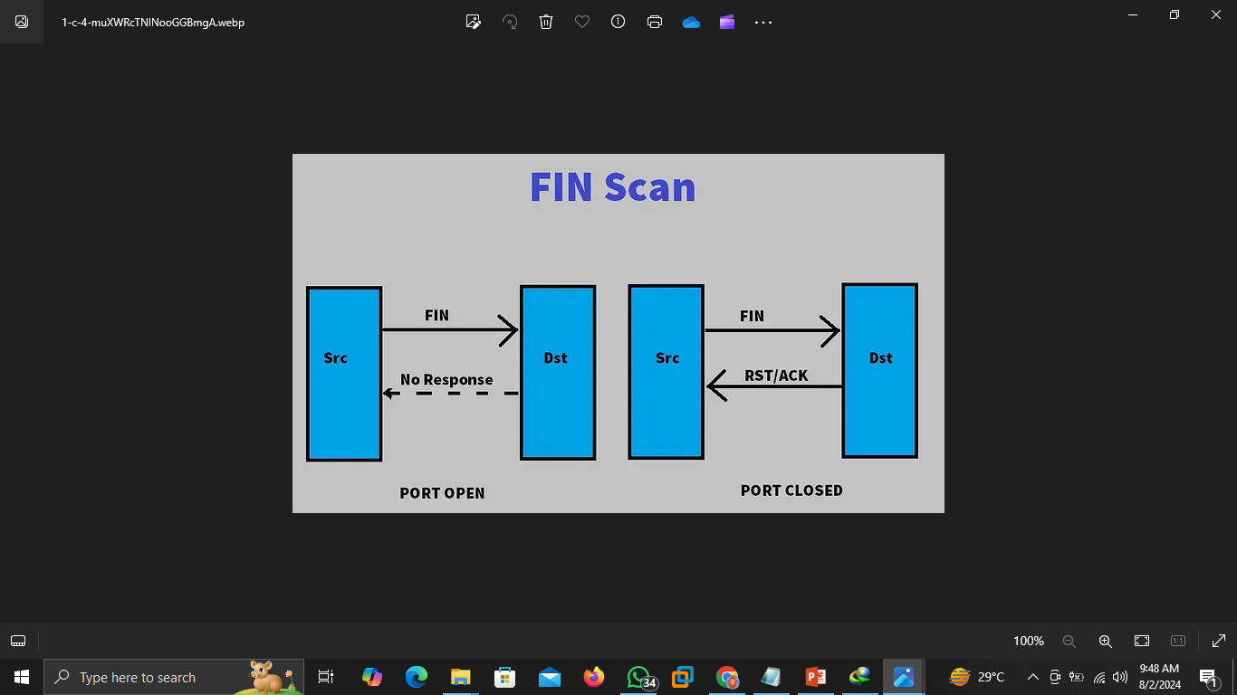
Network Scanning Fundamentals

Slide 6
Network Scanning Fundamentals
Port Scanning Techniques
Definition:
Port scanning involves sending packets to specific ports on a host to determine the status of the ports (open, closed, or filtered). It is used to identify which services are running on a host.
Examples:
1. TCP Connect Scan: A complete three-way handshake is performed to establish a connection, revealing open ports.
2. UDP Scan: Checks for open UDP ports by sending UDP packets and waiting for a response.
Techniques and Tools:
Techniques:
- TCP connect scan
- UDP scan
- Idle scan
Tools/Websites:
Nmap: Supports both TCP and UDP scans.
Masscan: Known for its speed, capable of scanning large networks quickly.

Slide 7

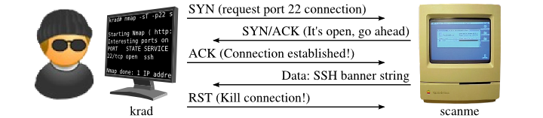
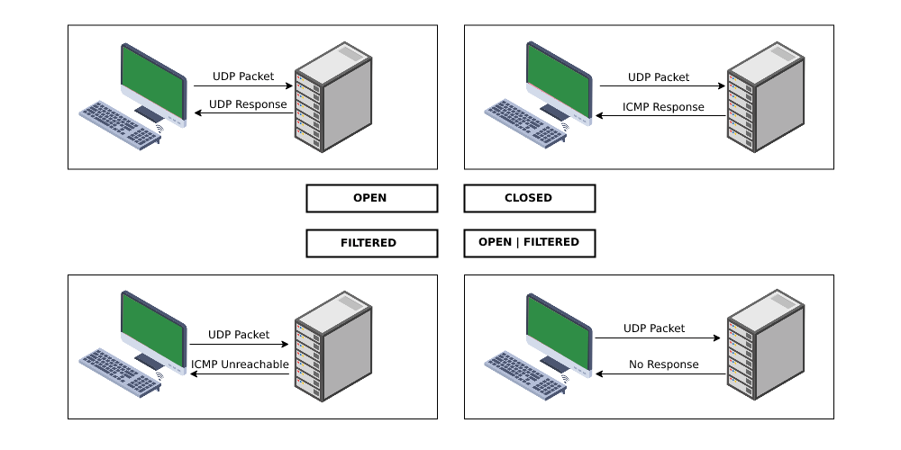
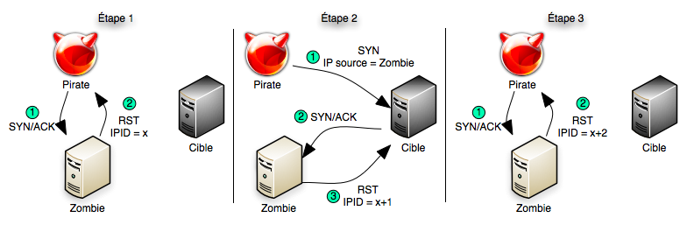
Network Scanning Fundamentals

Slide 8
Most powerful Tools/Websites
01
Nmap/ Zenmap
https://nmap.org/
https://nmap.org/docs.html
https://nmap.org/book/
Nmap -h
02
Masscan
https://www.kali.org/tools/masscan/
https://github.com/robertdavidgraham/masscan.git
Masscan -h
03
Angry IP Scanner
https://angryip.org/
https://angryip.org/documentation/
https://angryip.org/about/
java -jar ipscan.jar -h
04
Wireshark
https://www.wireshark.org/
https://www.wireshark.org/docs/
https://www.wireshark.org/docs/wsug_html_chunked/
wireshark -h

Slide 9
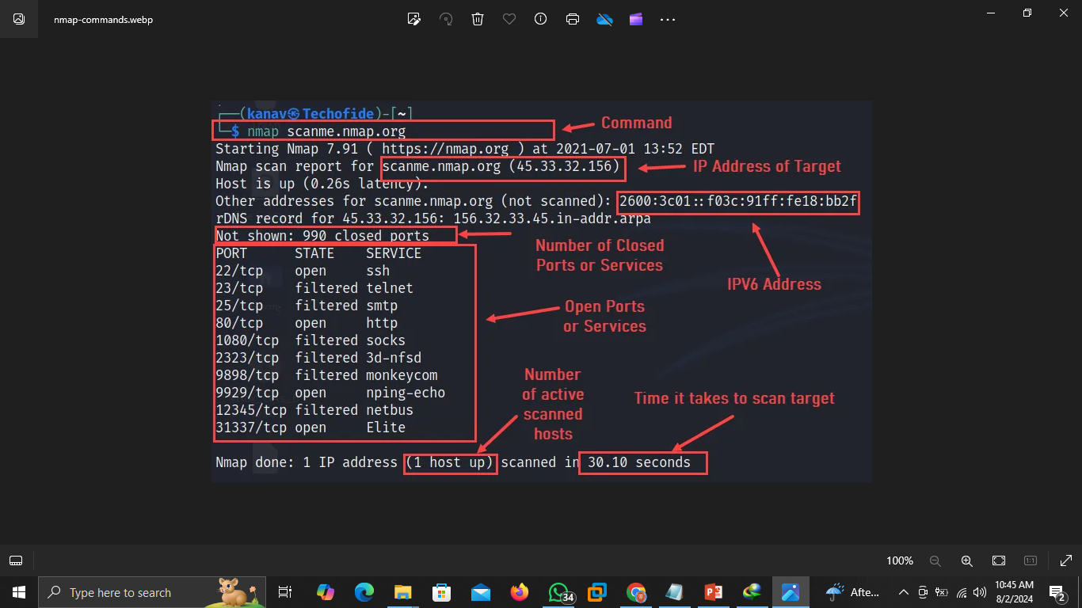

TCP Connect Scanning
Definition:
TCP Connect Scanning is a port scanning method that completes the TCP three-way handshake to determine if a port is open. It is reliable but easily detectable.
Examples:
1. Complete Handshake:A scanner completes the SYN, SYN-ACK, ACK handshake, confirming the port is open if the handshake succeeds.
2. Service Identification: By completing a connection, the scanner can also interact with the service to gather more information.
Techniques and Tools:
Full TCP handshake scanning
Tools/Websites:
Nmap: Uses `-sT` option for TCP connect scans.
Netcat:Can be used to establish TCP connections manually.

Slide 10
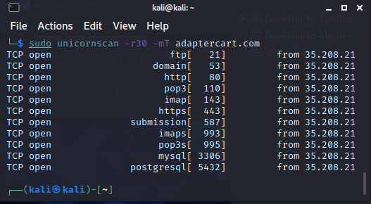
UDP Scanning
Definition:
UDP Scanning involves sending UDP packets to target ports to discover open ports. It is slower and more complex than TCP scanning due to the lack of acknowledgment in UDP communication.
Examples:
DNS Server Discovery: Sending a UDP packet to port 53 to check if a DNS service is running.
2.VoIP Service Check: Scanning port 5060 to see if a SIP service is active.
Techniques and Tools:
- Sending crafted UDP packets
- Analyzing ICMP port unreachable messages
Tools/Websites:
Nmap:Uses `-sU` option for UDP scans.
Unicornscan:Capable of high-performance UDP scanning.

Slide 11

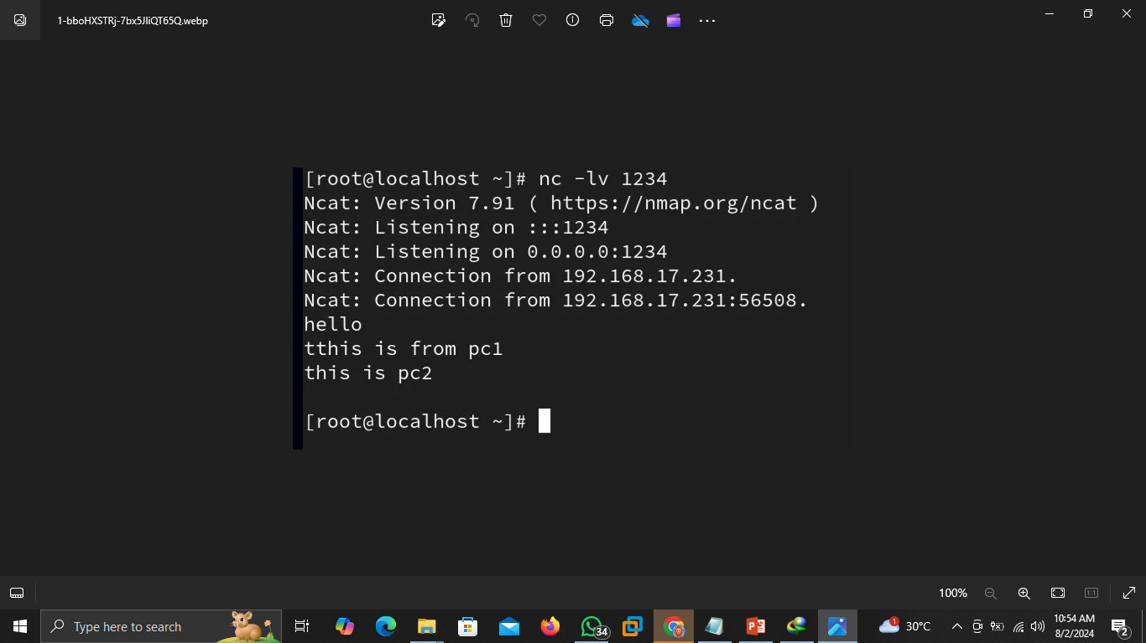
Banner Grabbing
Definition:
Banner grabbing is the technique of capturing service banners (information) from open ports to identify software
versions and services running on a server.
Examples:
1. Web Server Identification: Connecting to port 80 to retrieve the HTTP banner, revealing the web server type and version.
2. FTP Server Detection: Connecting to port 21 and reading the banner to identify the FTP software version.
Techniques and Tools:
- Manual connection via telnet/netcat
- Automated scripts and tools
Tools/Websites:
Netcat:Useful for manual banner grabbing.
Telnet: Can connect to specific ports to retrieve banners.
Nmap: Uses the `-sV` option for version detection.

Slide 12
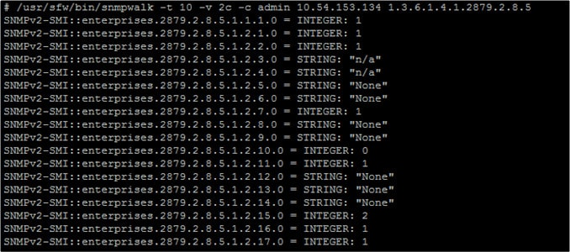
Network Enumeration Methods
Definition:
Network enumeration is the process of discovering and mapping network resources, including devices, shares, and services. It helps in identifying the structure and resources of a network.
Examples:
1. Active Directory Enumeration: Discovering domain controllers and active directory objects in a Windows network.
2. SNMP Enumeration:Retrieving network device information using SNMP protocol
Techniques and Tools:
- SNMP enumeration
- LDAP enumeration
- NetBIOS enumeration
Tools/Websites:
Nmap: With specific scripts for SNMP and LDAP enumeration.
SNMPwalk: Queries SNMP-enabled devices for information.

Slide 13

Scanning Tools and Utilities
Definition:
Various tools and utilities are used for network scanning, each offering different features and capabilities for network discovery, port scanning, and vulnerability assessment.
Examples:
1. Nmap: A versatile tool for network discovery and security auditing.
2. Wireshark: A network protocol analyzer for capturing and analyzing network traffic.
Techniques and Tools:
Tools:
Nmap: Network exploration and security auditing.
Wireshark: Packet capturing and analysis.
Zenmap: GUI for Nmap, providing visual representation.
Angry IP Scanner: Simple and fast IP address scanne.

Slide 14

Nmap – Network Mapper
Definition:
Nmap (Network Mapper) is an open-source tool used for network exploration, management, and security auditing. It provides features for host discovery, port scanning, service detection, and more.
Examples:
1. Host Discovery: Using Nmap to find active hosts on a network.
2. Service Detection: Identifying services running on open ports and their versions.
Techniques and Tools:
Nmap Features:
- Host discovery (`-sn`)
- Port scanning (`-sS`, `-sT`, `-sU`)
- Service/version detection (`-sV`)
- OS detection (`-O`)
Website:
- [Nmap Official Site](https://nmap.org/): Offers downloads, documentation, and tutorials..

Slide 15

Ping Sweeps and Sweep Detection
Definition:
Ping sweeps involve sending ICMP Echo requests to a range of IP addresses to identify which hosts are alive. Sweep detection refers to identifying and mitigating ping sweep activities as they can indicate reconnaissance efforts.
Examples:
1. Network Discovery: Using a ping sweep to map active hosts in a subnet.
2. Sweep Detection: Implementing firewall rules to detect and block excessive ICMP traffic from potential attackers.
Techniques and Tools:
- ICMP Echo requests
- Monitoring for abnormal ICMP traffic patterns
Tools/Websites:
Fping: A tool for performing ping sweeps efficiently.
Nmap: Uses `-sn` for host discovery using ping.

Slide 16
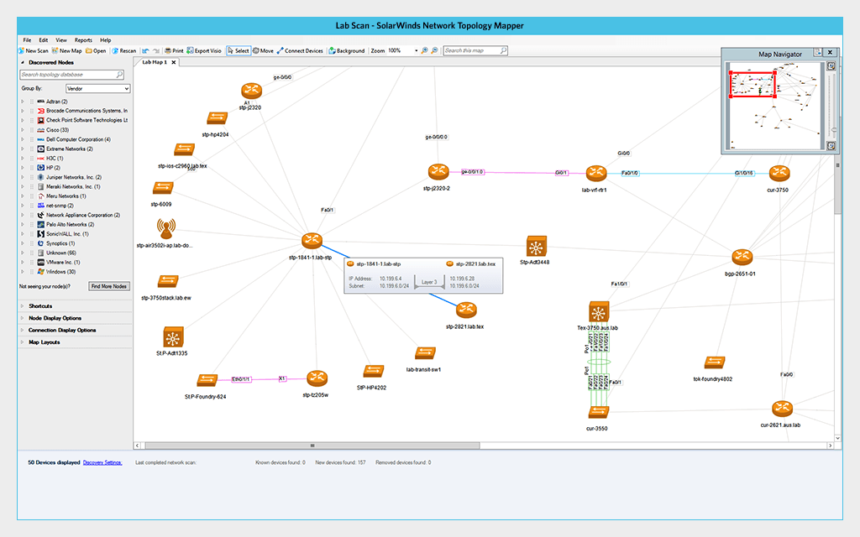
Network Mapping and Topology Discovery
Definition:
Network mapping and topology discovery involve identifying the layout and structure of a network, including devices, connections, and paths. It helps in understanding network architecture and identifying potential security weaknesses.
Examples:
1. Topology Visualization: Creating a visual map of a corporate network to identify key devices and connections.
2. Route Discovery: Mapping the paths between devices to analyze network performance and detect bottlenecks.
Techniques and Tools:
- Traceroute
- SNMP-based topology mapping
Tools/Websites:
Nmap: Supports network topology mapping with the `-sn` option.
SolarWinds Network Topology Mapper: A tool for automated network mapping.
Lucidchart: Online tool for creating network diagrams and maps.

Slide 17
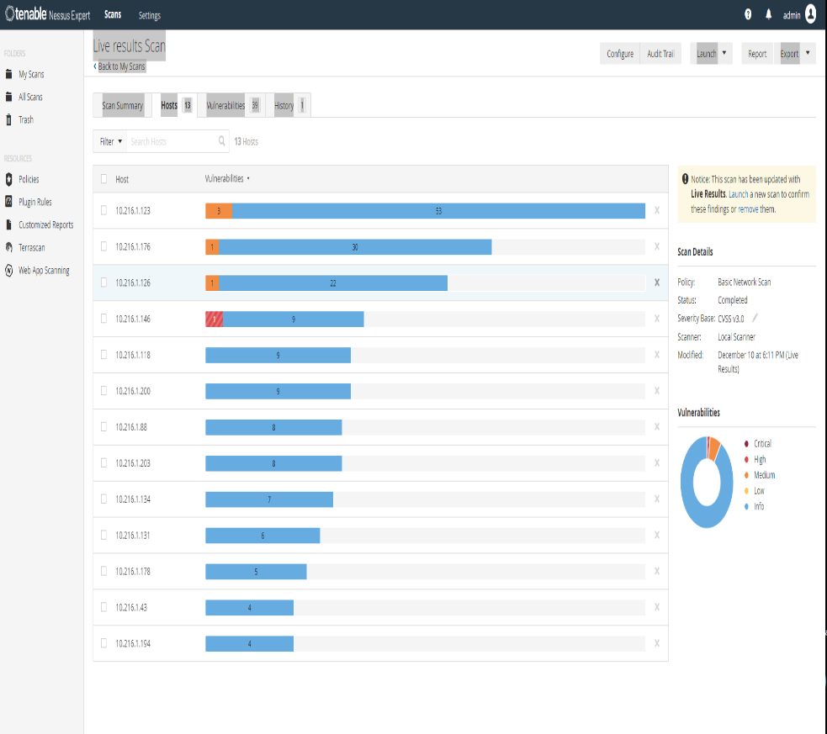
Vulnerability Scanning
Definition:
Vulnerability scanning is the process of identifying security weaknesses in a network or system by analyzing services, applications, and devices for known vulnerabilities.
Examples:
1. Web Application Scan: Scanning a web application to identify vulnerabilities such as SQL injection or cross-site scripting.
2. Network Device Scan: Scanning routers and switches to detect outdated firmware and configuration issues.
Techniques and Tools:
- Automated vulnerability detection
- Risk assessment based on vulnerability findings
Tools:
Nessus: A popular vulnerability scanner for networks and applications.
OpenVAS: An open-source vulnerability scanner.
Qualys: Provides cloud-based vulnerability scanning services.

Slide 18
Thank You!
Happy Hacking

